Slide 1


Unity
Game examples
Vicent Selfa
Curs 2020/2021
Notes:
‹#›

Slide 2
Index
First person games
Third person games
A game with scenes
Building a game for the Android platform
Destroy stones game
Destroy stones with scenes
Destroy stones game with Android
Annexes:
Visual Studio Code tips
Document control versions
Notes:
‹#›

Slide 3
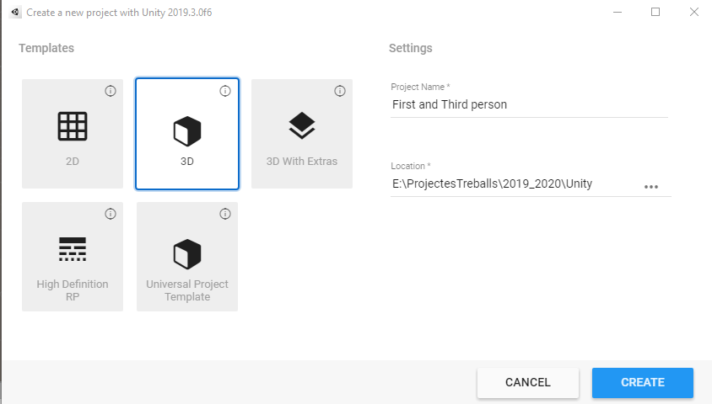

First person games
Playing using the first person
Are those in which the camera is put in the eyes of the player, so we do not see anything of him.
We only could see in some cases the hands or the weapons that this character is holding.
Therefore, we see all reality only and exclusively from his eyes, I mean, the camera are the eyes of the player
Notes:
‹#›

Slide 4
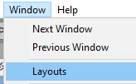
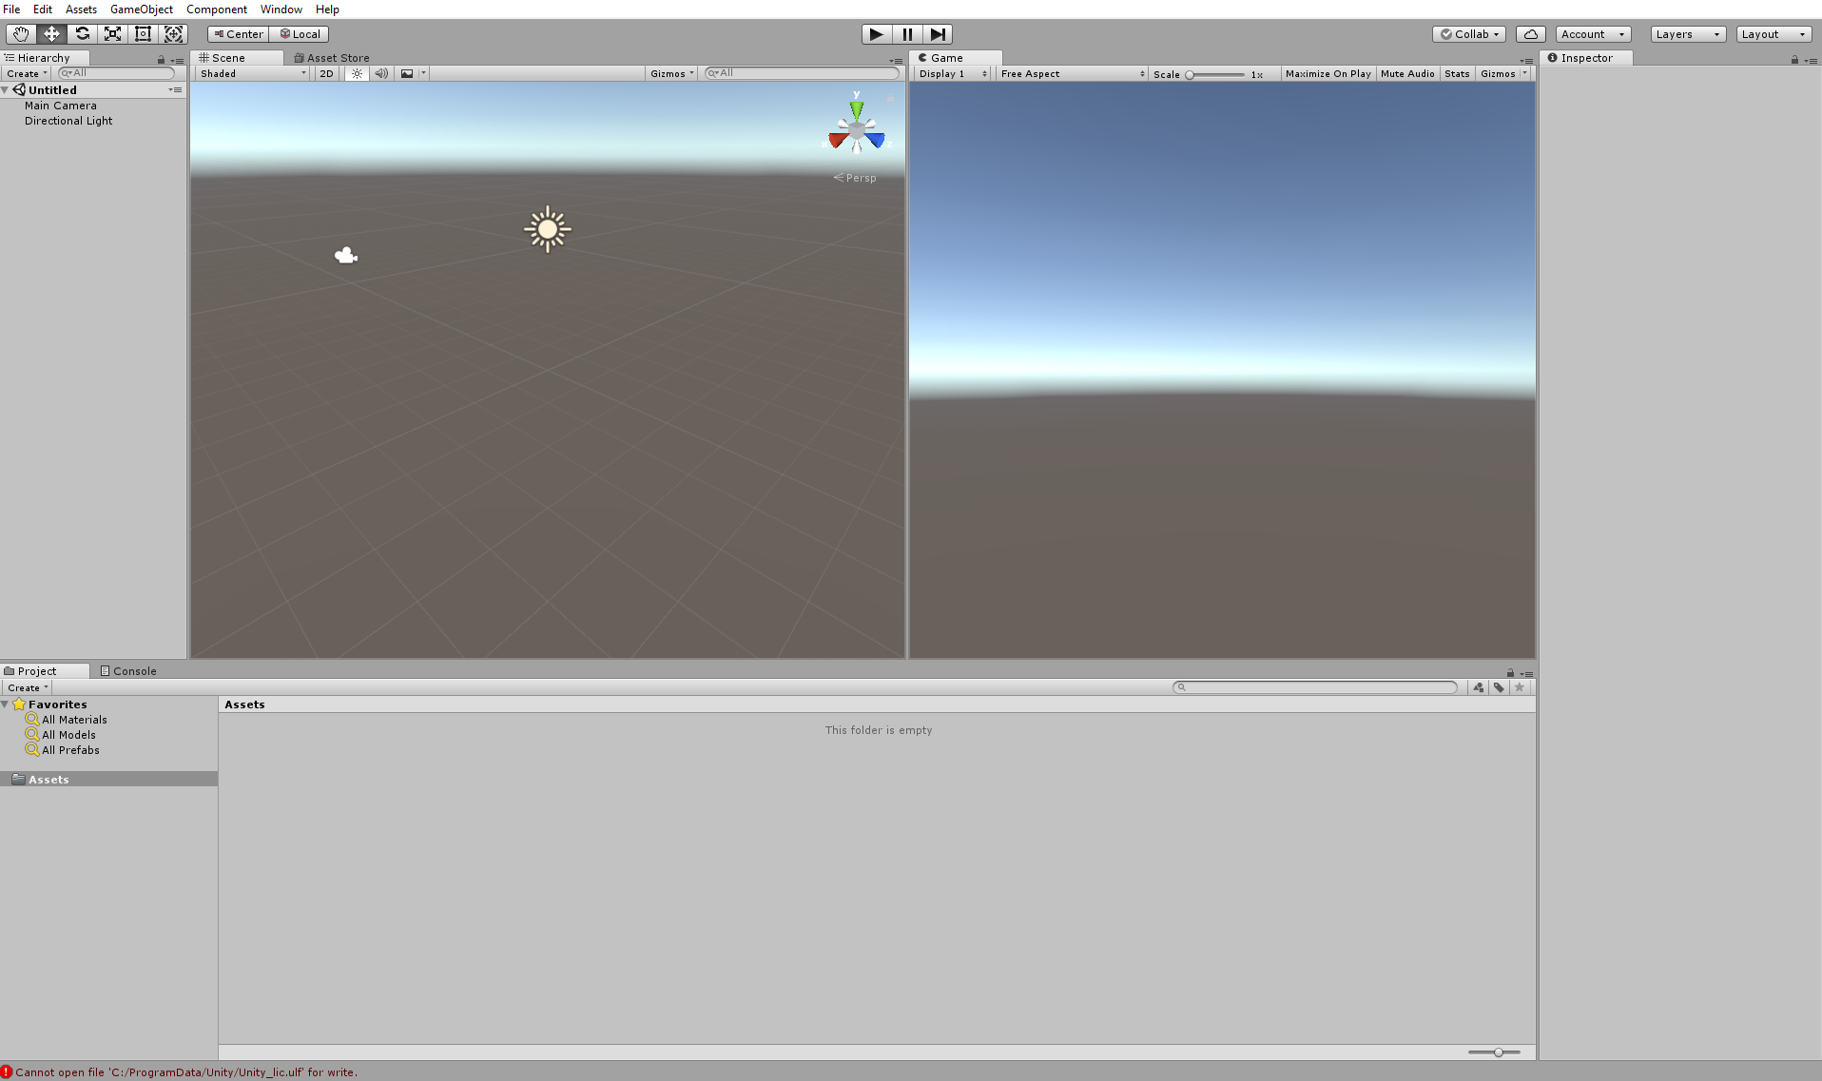
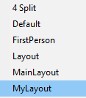
First person games: Layout
Notes:
‹#›

Slide 5
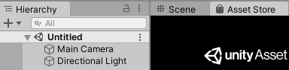
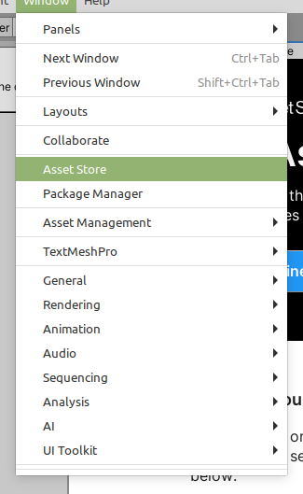

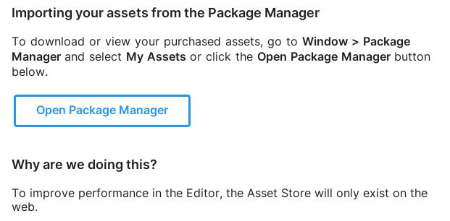
First person games: Assets
Importing assets
Notes:
‹#›

Slide 6
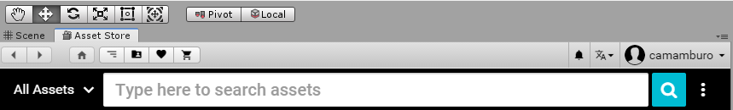
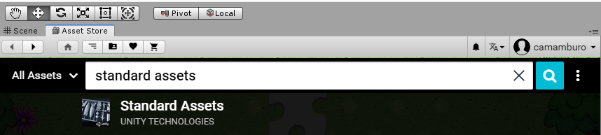
First person games: Import packages
Notes:
‹#›

Slide 7
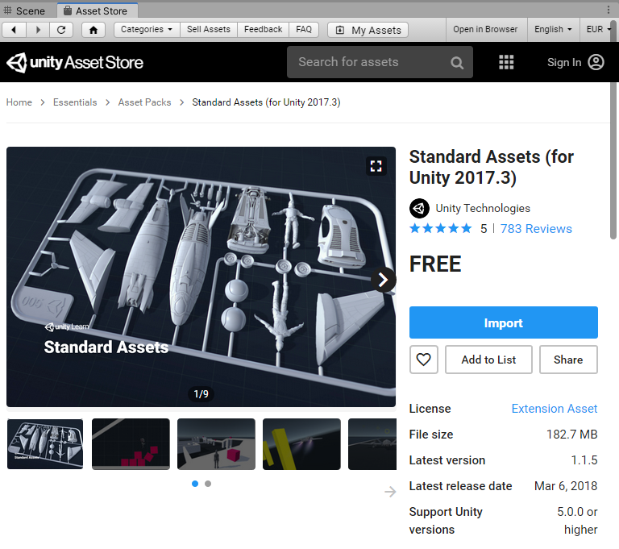
First person games: Import packages
Notes:
‹#›

Slide 8
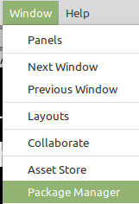

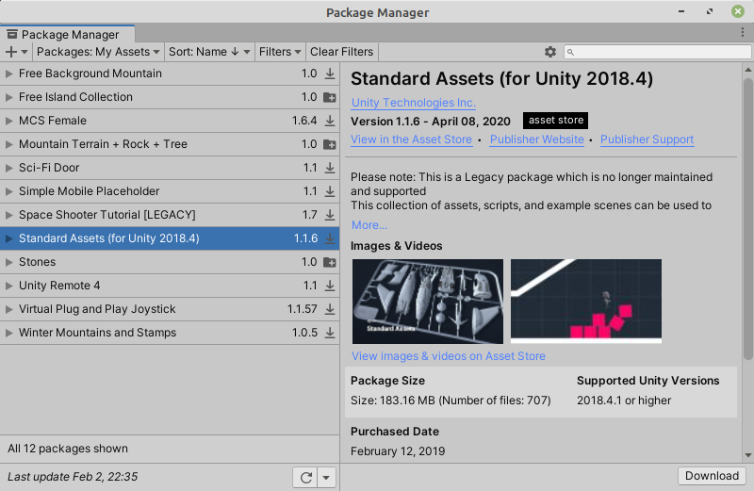
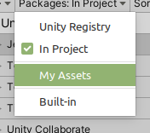
First person games: Import packages
Notes:
‹#›

Slide 9

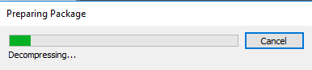
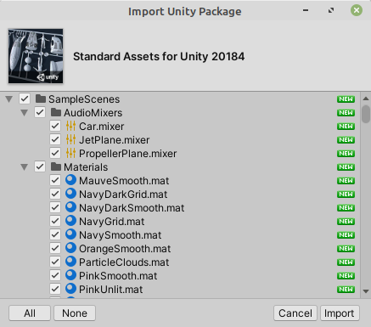
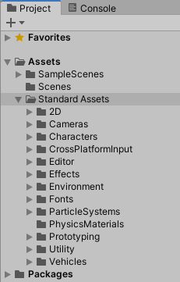
First person games: Import packages
Best option: Install all the components to avoid missing references
Notes:
‹#›

Slide 10
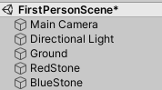
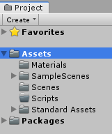
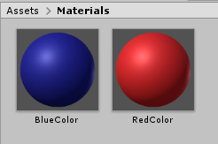
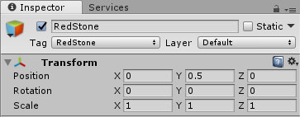
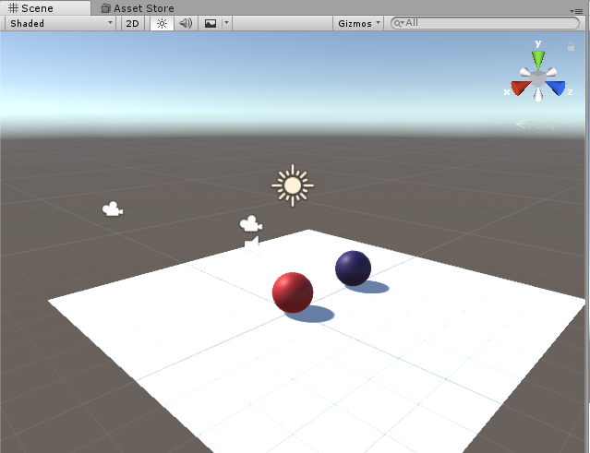
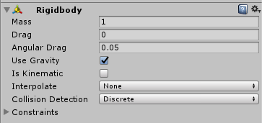
First person games:
Materials, ground, spheres …
Notes:
‹#›

Slide 11
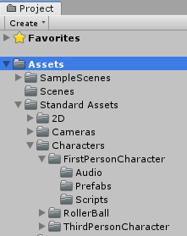
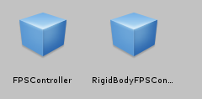
First person games:
The first person prefab.
Our first person prefab
Notes:
‹#›

Slide 12
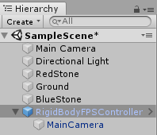
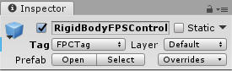
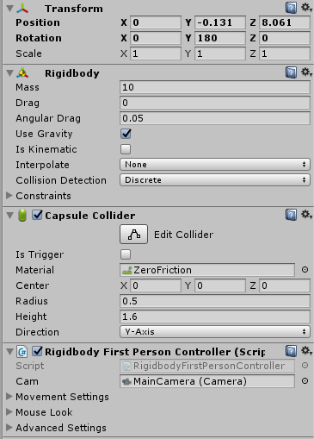
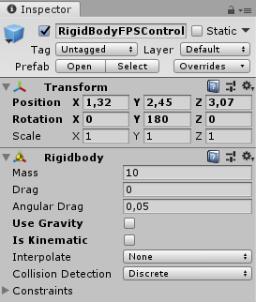
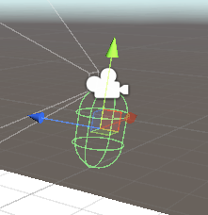
First person games:
The first person prefab.
Try unchecking Use Gravity. What’s the difference?
Notes:
‹#›

Slide 13
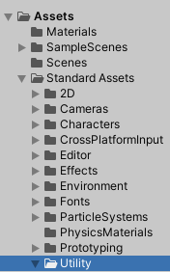
First person: Playing the game!
Attention.- How to solve:
Unity error CS0619: 'GUITexture' is obsolete: 'GUITexture has been removed. Use UI.Image instead.'
Unity Component at index 2 could not be loaded when loading gameobject 'Main Camera'. Removing it!
SimpleActivatorMenu.cs
using System;
using UnityEngine;
using UnityEngine.UI; // For the Text class
namespace UnityStandardAssets.Utility
{
public class SimpleActivatorMenu : MonoBehaviour
{
// An incredibly simple menu which, when given references
// to gameobjects in the scene
// public GUIText camSwitchButton;
public Text camSwitchButton;
public GameObject[] objects;
// More code
}
ForcedReset.cs
using System;
using UnityEngine;
using UnityEngine.SceneManagement;
using UnityStandardAssets.CrossPlatformInput;
using UnityEngine.UI; // For the Text class
// [RequireComponent(typeof (UI.Text))]
public class ForcedReset : MonoBehaviour
{
// More code
}
Another solution for this problems here
Notes:
‹#›

Slide 14
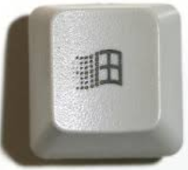

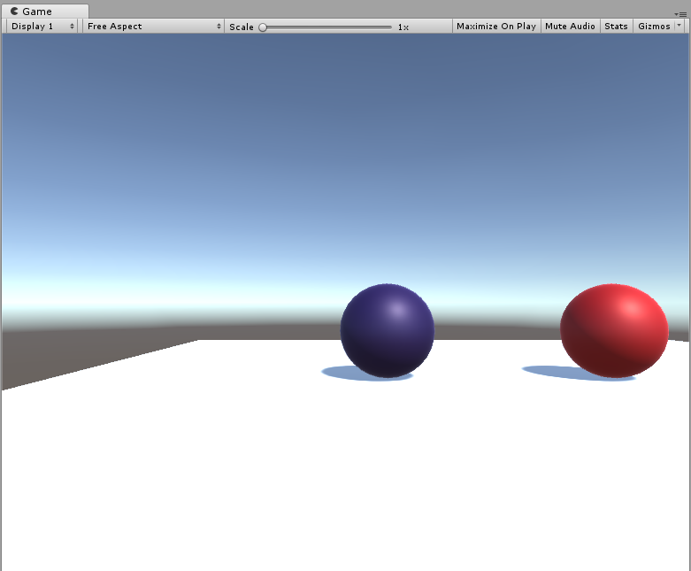

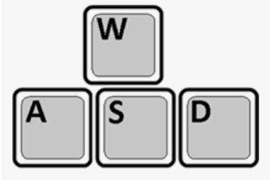
First person: Playing the game!
Run the game, move across the ground using arrows, w-a-s-d keys or space bar.
After a few moments of playing… try to exit from the play mode!
Could be this keys can help you:
Notes:
‹#›

Slide 15
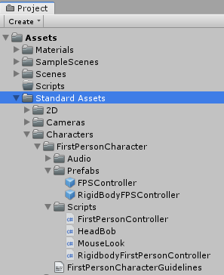
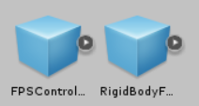
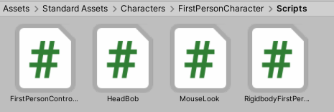
First person games
Exercise: Destroy the ball. The script on the first person character
The game object: A first person character
The script to manage the first person character: RigidbodyFirstPersonController
Notes:
‹#›

Slide 16


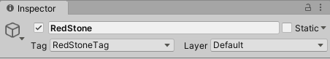
First person games
Exercise: Destroy the ball. The code on the first person character script
The scrip to manage the first person character: RigidbodyFirstPersonController
namespace UnityStandardAssets.Characters.FirstPerson{
[RequireComponent(typeof (Rigidbody))]
[RequireComponent(typeof (CapsuleCollider))]
public class RigidbodyFirstPersonController : MonoBehaviour {
private void OnCollisionEnter(Collision collision) {
if (collision.gameObject.tag == "RedStoneTag") {
print("Xoc amb la bola roja!!!");
Destroy(collision.gameObject);
}
}
// More code …
Notes:
‹#›

Slide 17
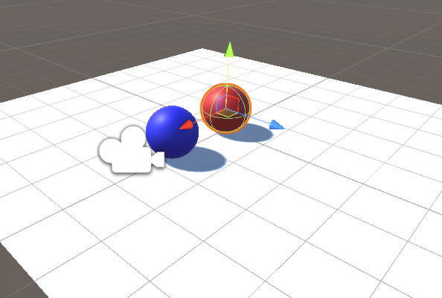
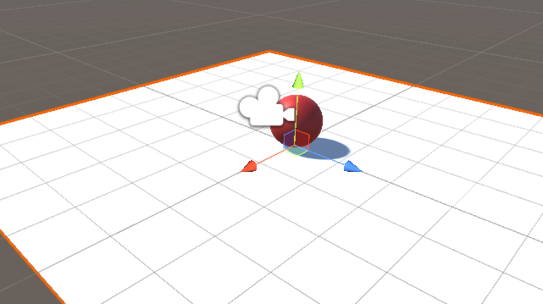
First person games
Exercise: Destroy the ball.
Notes:
‹#›

Slide 18

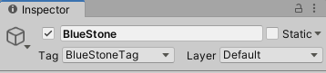
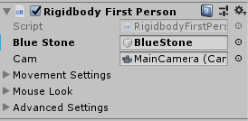

First person games
Exercise: Follow the First Person Character after colliding with it
The game objects: Tag the blue stone
The scripts: RigidbodyFirstPersonController
// Add the next code into the OnCollisionEnter method
if (collision.gameObject.tag == "BlueStoneTag") {
blueStone.SendMessage("Follow");
}
// And add the next attribute
public GameObject blueStone;
Notes:
‹#›

Slide 19
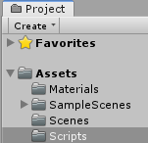
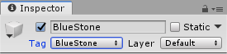
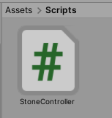
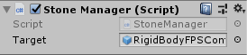
First person games
Exercise: Follow the First Person Character after colliding with it
The scripts: StoneController
Notes:
‹#›

Slide 20
First person games
Exercise: Follow the First Person Character after colliding with it
The script: StoneController. Methods: Follow and LateUpdate
public class StoneController : MonoBehaviour {
// To follow an object keeping an offset distance
public GameObject target; // The first person object to follow
private Vector3 offset; // The distance
private bool following = false; private Rigidbody rigidBody;
// Use this for initialization
void Start() { rigidBody = GetComponent<Rigidbody>(); }
// Update is called once per frame
void Update() { }
void Follow() { // Initial values when a message is sent to Follow
offset = transform.position - target.transform.position;
following = true;
}
void LateUpdate() { // To move the càmera AFTER the sphere
if (following){
// To update the position of the camera AFTER the update of the sphere
transform.position = target.transform.position + offset;
}
}
}
Notes:
‹#›

Slide 21
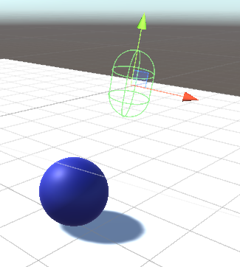
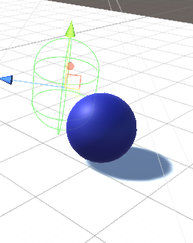
First person games
Exercise: Follow the First Person Character after colliding with it
Before
OnCollisionEnter
After
OnCollisionEnter
Notes:
‹#›

Slide 22
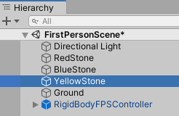
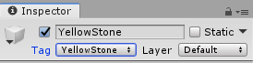
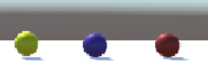
First person games
Exercise: Making an impulse to the yellow stone after colliding with it
Notes:
‹#›

Slide 23

First person games
Exercise: Making an impulse to the yellow stone after colliding with it
The script: RigidbodyFirstPersonController.
Modify this method adding a code to call the method Impuls(), using SendMessage().
public GameObject yellowStone;
private void OnCollisionEnter(Collision collision) {
if (collision.gameObject.tag == "YellowStone") {
yellowStone.SendMessage("Impuls");
}
}
Notes:
‹#›

Slide 24



First person games
Exercise: Making an impulse to the stone after colliding with it
The script: StoneController. Method: Impuls
public int jumpValue = 3;
void Impuls() {
rigidBody.AddForce(Vector3.up * jumpValue, ForceMode.Impulse);
}
Notes:
‹#›

Slide 25



First person games
Exercise: Making an impulse to the stone after colliding with it
Add sounds to the different actions
private AudioSource audioSourceBoing; // The sound for the impulse
void Start() {
rigidBody = GetComponent<Rigidbody>();
audioSourceBoing = GetComponent<AudioSource>();
}
void Impuls() {
rigidBody.AddForce(Vector3.up * jumpValue, ForceMode.Impulse);
audioSourceBoing.Play();
}
Notes:
‹#›

Slide 26
First person games
Another way of programming all the actions, using ONLY a FPStoneController script
public class FPStoneController : MonoBehaviour { // Only ONE class to control all the stones
private Rigidbody rigidBody; private Vector3 offset; // The distance
private bool following = false; public GameObject target; // The target to follow
void Start() {
rigidBody = GetComponent<Rigidbody>(); }
void OnCollisionEnter(Collision other) {
if (other.gameObject.tag == "FPCTag") { // Interacting ONLY with the First Person Controller
if (gameObject.tag == "RedStoneTag") { print("Xoc amb la bola roja!!"); Destroy (gameObject); }
if (gameObject.tag == "BlueStoneTag") {
if (!following) { following = true; print("Xoc amb la bola blava!!");
offset = gameObject.transform.position - target.transform.position;
}
else { print("Seguint bola blava!!"); }
}
if (gameObject.tag == "YellowStoneTag") { print("Xoc amb la bola groga!!");
rigidBody.AddForce(Vector3.forward * Random.Range(1, 5), ForceMode.Impulse);
}
ControlCollisions.incNumCollisions(); print("Num. colisions: " + ControlCollisions.getNumCollisions());
}
}
void LateUpdate() { // To update the position of the camera AFTER the update of the sphere
if (following){
if (gameObject.tag == "BlueStoneTag") {gameObject.transform.position = target.transform.position + offset;}
}
}
}
Notes:
‹#›

Slide 27
First person games
Another way of programming all the actions, using ONLY a FPStoneController script
The static class ControlCollisions.cs
public static class ControlCollisions {
private static int numCollisions = 0;
public static void incNumCollisions () {
numCollisions++;
}
public static int getNumCollisions () {
return numCollisions;
} }
Notes:
‹#›

Slide 28






First person games
Another way of programming all the actions, using ONLY a FPStoneController script
Notes:
‹#›

Slide 29

Third person games
Notes:
‹#›

Slide 30

Third person games
Notes:
‹#›

Slide 31





Third person games
Copy and paste the previous scene, so we are keeping all the previous game objects.
Then rename the new scene as ThirdPerson
Notes:
‹#›

Slide 32




Third person games
Remove the RigidbodyFPSController game object
And add a ThirdPersonController game object
Notes:
‹#›

Slide 33

Third person games
The new ThirdPerson scene
Notes:
‹#›

Slide 34


Third person games
Playing third person games: Destroying, impelling or getting stones
The scrip to manage the third person character: ThirdPersonController
Modify the ThirdPersonUserControl.cs to manage the next situations:
If you collide a red stone destroy it
If you collide a yellow stone, make it an impulse
If you collide a blue stone, make it to follow you
Notes:
‹#›

Slide 35


Third person games
Playing third person games: Destroying, impelling or getting stones
The script to manage the third person character: ThirdPersonController
// References to the 3 stones using public variables
public GameObject blueStone;
public GameObject redStone;
public GameObject yellowStone;
private void OnCollisionEnter(Collision collision) {
if (collision.gameObject.tag == "RedStone") { Destroy(collision.gameObject);}
if (collision.gameObject.tag == "BlueStone") { blueStone.SendMessage("Follow"); }
if (collision.gameObject.tag == "YellowStone") { yellowStone.SendMessage("Impuls"); }
}
Notes:
‹#›

Slide 36
Third person games
Playing third person games: Destroying, impelling or getting stones
public class StoneController : MonoBehaviour {
// To follow an object keeping an offset distance
public GameObject target;
private Vector3 offset; // The object to follow and the distance
private bool following = false; private Rigidbody rigidBody;
void Start () { rigidBody = GetComponent<Rigidbody>(); }
void Update () { }
void Follow() {
offset = transform.position - target.transform.position; following = true;
}
void LateUpdate() {
if (following) {
// To update the position of the camera AFTER the update of the sphere
transform.position = target.transform.position + offset;
}
}
void Impuls() {
rigidBody.AddForce(Vector3.forward * Random.Range(1, 5), ForceMode.Impulse);
}
}
Notes:
‹#›

Slide 37



Third person games
Playing third person games: Destroying, impelling or getting stones
Notes:
‹#›

Slide 38
Third person games
Another way of programming all the actions, using ONLY a TPStoneController script
public class TPStoneController : MonoBehaviour { // Only ONE class to control all the stones
private Rigidbody rigidBody; private Vector3 offset; // The distance
private bool following = false; public GameObject target; // The target to follow
void Start() {
rigidBody = GetComponent<Rigidbody>(); offset = gameObject.transform.position - target.transform.position;
}
void OnCollisionEnter(Collision other) {// Interacting with the First and Third Person Controllers
// The only one change required
if (other.gameObject.tag == “TPCTag") {
if (gameObject.tag == "RedStoneTag") { print("Xoc amb la bola roja!!"); Destroy (gameObject); }
if (gameObject.tag == "BlueStoneTag") {
if (!following) { following = true; print("Xoc amb la bola blava!!");
offset = gameObject.transform.position - target.transform.position;
}
}
if (gameObject.tag == "YellowStoneTag") { print("Xoc amb la bola groga!!");
rigidBody.AddForce(Vector3.forward * Random.Range(1, 5), ForceMode.Impulse);
}
ControlCollisions.incNumCollisions(); print("Num. colisions: " + ControlCollisions.getNumCollisions());
}
}
void LateUpdate() { // To update the position of the camera AFTER the update of the sphere
if (following){
if (gameObject.tag == "BlueStoneTag") {gameObject.transform.position = target.transform.position + offset;}
}
}
}
Notes:
‹#›

Slide 39





Third person games
Another way of programming all the actions, using ONLY a TPStoneController script
Notes:
‹#›

Slide 40



A game with scenes
Creating the Awake and Final scene
Notes:
‹#›

Slide 41




A game with scenes
Our first scene: Awake
A child of Canvas
Notes:
‹#›

Slide 42




A game with scenes
Our first scene.- Awake with buttons inside the canvas: FPButton
<
<
<
<
<
Notes:
‹#›

Slide 43





A game with scenes
Adding music to the first scene
Exercise: Add different kind of songs to the different actions.
Notes:
‹#›

Slide 44



A game with scenes
Our first scene.- Awake with buttons: TPButton
<
Notes:
‹#›

Slide 45



A game with scenes
The script to manage the scenes: InterfaceAwake.cs
using System.Collections;
using System.Collections.Generic;
using UnityEngine;
using UnityEngine.SceneManagement;
public class InterfaceAwake : MonoBehaviour {
public void GoFirstPerson () {
SceneManager.LoadScene ("FirstPerson");
}
}
Notes:
‹#›

Slide 46



A game with scenes
Linking the button with the InterfaceAwake: Selecting the object
Notes:
‹#›

Slide 47



A game with scenes
Linking the button with the InterfaceAwake.- Selecting the method:
Exercise: Create a new method GoThridPerson() and link it to the second button
If you try to run the game now there will appear an error:
To add a scene to the build settings use the menu File->Build Settings...
Notes:
‹#›

Slide 48


A game with scenes
Our Final scene with a button. Add a Canvas with a button:
<
Notes:
‹#›

Slide 49




A game with scenes
Putting all the scenes together and running the game from the Awake scene
Open the scenes and add them using the button
Notes:
‹#›

Slide 50




A game with scenes
Putting all the scenes together and running the game from the Awake scene
Create a new folder for the game
Notes:
‹#›

Slide 51




A game with scenes
The final result
Take a look to the final project here in GitHub
Notes:
‹#›

Slide 52

A game … with Android
Notes:
‹#›

Slide 53



A game … with Android: The new platform
Switching the platform
Notes:
‹#›

Slide 54

A game … with Android: The new platform
Switching the platform
Notes:
‹#›

Slide 55



A game … with Android: The assets
The Cross Platform Input assets
Notes:
‹#›

Slide 56

A game … with Android: The assets
Notes:
‹#›

Slide 57




A game with scenes … with Android
The Project Settings for the Android platform.
Notes:
‹#›

Slide 58



A game … with Android
Building the game for the Android platform.
Download the complete project here
Notes:
‹#›

Slide 59



A game … with Android
Building the game for the Android platform.
Notes:
‹#›

Slide 60





A game … with Android
Building the game for the Android platform.
Notes:
‹#›

Slide 61





A game … with Android
And playing the game in the mobile!
Notes:
‹#›

Slide 62

Destroy Stones
Game
Download the complete project here
Notes:
‹#›

Slide 63

Destroy Stones Game
Creating a new game: DestroyStones
Download the Destroy Stone game here
Notes:
‹#›

Slide 64



Destroy Stones Game
Creating folders
Saving the scene
Notes:
‹#›

Slide 65
Destroy Stones Game
Importing assets
Notes:
‹#›

Slide 66


Destroy Stones Game
Importing assets
Notes:
‹#›

Slide 67


Destroy Stones Game
Importing assets
Notes:
‹#›

Slide 68

Destroy Stones Game
View the assets
Notes:
‹#›

Slide 69





Destroy Stones Game
Creating prefabs
Using materials
The Stones prefabs
The Stones prefabs
Notes:
‹#›

Slide 70
Destroy Stones Game
Creating scripts
MainLoop.cs
using UnityEngine;
using System.Collections;
public class MainLoop : MonoBehaviour {
public GameObject[] stones = new GameObject[3]; // An array of GameObjects
public float torque = 5.0f; // Spacial force to provoque a rotation
// Different min and max values to give random to the stones
public float minAntiGravity = 20.0f, maxAntiGravity = 40.0f;
public float minLateralForce = -15.0f, maxLateralForce = 15.0f;
public float minTimeBetweenStones = 1f, maxTimeBetweenStones = 3f;
public float minX = -5.0f, maxX = 5.0f;
public float minZ = -5.0f, maxZ = 5.0f;
private bool enableStones = true;
private Rigidbody rigidBody;
// Use this for initialization
void Start() { StartCoroutine(ThrowStones()); }
// To run the coroutine
IEnumerator ThrowStones() { //TODO }
}
Notes:
‹#›

Slide 71
Destroy Stones Game
MainLoop.cs
IEnumerator ThrowStones() {
// Initial delay
yield return new WaitForSeconds(2.0f);
while (enableStones) {
// Random values for: the kind of stone, position and rotation of the initial values
GameObject stone = (GameObject) Instantiate(stones[Random.Range(0, stones.Length)]);
stone.transform.position = new Vector3(Random.Range(minX, maxX), -30.0f,
Random.Range(minZ, maxZ));
stone.transform.rotation = Random.rotation;
rigidBody = stone.GetComponent<Rigidbody>();
rigidBody.AddTorque(Vector3.up * torque, ForceMode.Impulse);
rigidBody.AddTorque(Vector3.right * torque, ForceMode.Impulse);
rigidBody.AddTorque(Vector3.forward * torque, ForceMode.Impulse);
rigidBody.AddForce(Vector3.up * Random.Range(minAntiGravity, maxAntiGravity),
ForceMode.Impulse);
rigidBody.AddForce(Vector3.right * Random.Range(minLateralForce, maxLateralForce),
ForceMode.Impulse);
// Next time to run the coroutine
yield return new WaitForSeconds(Random.Range(minTimeBetweenStones,
maxTimeBetweenStones));
}
}
Notes:
‹#›

Slide 72



Destroy Stones Game
Adding the script to the Main Camera
Notes:
‹#›

Slide 73



Destroy Stones Game
Adjusting the values of the Main Camera
Adjusting the Time Scale
Notes:
‹#›

Slide 74

Destroy Stones Game
A problem:
We never destroy the stones!!
Notes:
‹#›

Slide 75
Destroy Stones Game
Destroying the stones in a dynamically way
Stone.cs
public class Stone: MonoBehaviour {
// Distance to the stone be destroyed
private const float yDie = -30.0f;
// Use this for initialization
void Start () { }
// Update is called once per frame
void Update () {
// Position stone < yDie
if (transform.position.y < yDie) {
// Destroy the game to which this script is associated
Destroy(gameObject);
}
}
}
Notes:
‹#›

Slide 76


Destroy Stones Game
Destroying the stones in a dynamically way
Notes:
‹#›

Slide 77


Destroy Stones Game
Destroying the stones using the mouse. Add colliders to the stones
Notes:
‹#›

Slide 78
Destroy Stones Game
Destroying the stones using the mouse
Stone.cs
public class Stone: MonoBehaviour {
private const float yDie = -30.0f;
// Use this for initialization
void Start () { }
// Update is called once per frame
void Update () {
if (transform.position.y < yDie) {
Destroy(gameObject);
}
}
void OnMouseDown(){
// Detect if the object intercept the ray send by the mouse
Destroy(gameObject);
}
}
Notes:
‹#›

Slide 79

Destroy Stones Game: Explosion effect
Adding realism to our game: Explosion effect using a Particle System
Import the Standard Assets package
Notes:
‹#›

Slide 80

Destroy Stones Game: Explosion effect
Import the Standard Assets package
Notes:
‹#›

Slide 81
Destroy Stones Game
Adding the explosion effect to the script: The code
Stone.cs
using UnityEngine;
public class Stone: MonoBehaviour {
private const float yDie = -30.0f;
public GameObject explosion;
// Use this for initialization
void Start () { }
// Update is called once per frame
void Update () {
if (transform.position.y < yDie) { Destroy(gameObject); }
}
// Detect if the object intercept the ray
void OnMouseDown() {
// Create an explosion effect here, with no rotation
Instantiate(explosion, transform.position, Quaternion.identity);
Destroy(gameObject);
}
}
Notes:
‹#›

Slide 82



Destroy Stones Game: Explosion effect
Adding realism to our game: Explosion effect using a Particle System
Notes:
‹#›

Slide 83

Destroy Stones Game
Adding the explosion effect to the script
Notes:
‹#›

Slide 84



Destroy Stones Game
Adding sound to the Background
Notes:
‹#›

Slide 85

Destroy Stones Game
Adding sound to the explosions.
Notes:
‹#›

Slide 86
DestroyStones Game
Registering information about the game
An special static class GameManager
GameManager.cs
// A static class
public static class GameManger {
public static int currentNumberStonesThrow = 0;
public static int currentNumberStonesDestroyed = 0;
}
MainLoop.cs
IEnumerator ThrowStones() {
// Initial delay
yield return new WaitForSeconds(2.0f);
while (enableStones) {
// More code
// Incrementing the number of stones thrown
GameManager.currentNumberStonesThrow++;
yield return new
WaitForSeconds(Random.Range(minTimeBetweenStones,
maxTimeBetweenStones));
}
}
Notes:
‹#›

Slide 87
DestroyStones Game
Registering information about the game
An special static class GameManager
GameManager.cs
// An static class
public static class GameManager {
public static int currentNumberStonesThrow = 0;
public static int currentNumberStonesDestroyed = 0
}
Stone.cs
void OnMouseDown() {
// Create an explosion effect here, with no rotation
Instantiate(explosion, transform.position, Quaternion.identity);
Destroy(gameObject);
GameManager.currentNumberStonesDestroyed++;
}
Notes:
‹#›

Slide 88




DestroyStones Game
Showing the information of the game: Canvas
Notes:
‹#›

Slide 89

DestroyStones Game
Showing the information of the game: Canvas
Notes:
‹#›

Slide 90
DestroyStones Game
Showing the information of the game: Canvas
MainLoop.cs
// Complete the previous class adding the necessary code.
using UnityEngine.UI; // For the Text class
public Text numberStonesThrow, numberStonesDestroyed;
void Start() {
numberStonesThrow.text = "Stones thrown: ";
numberStonesDestroyed.text = "Stones destroyed: ";
StartCoroutine(ThrowStones());
}
IEnumerator ThrowStones() {
// Initial delay
yield return new WaitForSeconds(2.0f);
while (enableStones) {
// More code
// Incrementing the number of stones thrown
GameManager.currentNumberStonesThrow++;
ShowStonesNumber () ; // Showing the number of stones
yield return new WaitForSeconds(Random.Range(minTimeBetweenStones,
maxTimeBetweenStones));
}
}
void ShowStonesNumber () {
numberStonesThrow.text = "Stones thrown: “ + GameManager.currentNumberStonesThrow;
numberStonesDestroyed.text = "Stones destroyed: “+ GameManager.currentNumberStonesDestroyed;
}
Notes:
‹#›

Slide 91

DestroyStones Game
Showing the information of the game: Canvas
Notes:
‹#›

Slide 92

DestroyStones Game
Exercise: Add a Quit game button to finish the game
Notes:
‹#›

Slide 93

DestroyStones with scenes
Creating the Awake scene
Notes:
‹#›

Slide 94



DestroyStones with scenes
The input field for the player name and the init game button
Notes:
‹#›

Slide 95


DestroyStones with scenes
The script to manage the scenes: InterfaceAwake.cs
using System.Collections;
using System.Collections.Generic;
using UnityEngine;
using UnityEngine.SceneManagement;
public class InterfaceAwake : MonoBehaviour {
public InputField userName;
public void GoDestroyStonesGame() {
print ("User name = " + userName.text);
GameManager.setUserName (userName.text );
SceneManager.LoadScene("DestroyStonesGame");
}
}
InterfaceAwake.cs
Notes:
‹#›

Slide 96

A game with scenes
Linking the button with the InterfaceAwake: Selecting the object
Notes:
‹#›

Slide 97


A game with scenes
Linking the button with the InterfaceAwake.- Selecting the method.
To add a scene to the build settings use the menu File->Build Settings...
Notes:
‹#›

Slide 98
A game with scenes
The new GameManager script to manage the user name
using UnityEngine.UI; // For the Text class
// A static class to save number of stones and the user name
public static class GameManager {
public static int currentNumberStonesThrow = 0;
public static int currentNumberStonesDestroyed = 0;
public static string userName;
public static void setUserName (string name) {
userName = name;
}
public static string getUserName () {
return userName;
}
}
GameManager.cs
Notes:
‹#›

Slide 99



DestroyStones Game: Git / GitHub
Uploading the game to GitHub:
Notes:
‹#›

Slide 100

DestroyStones Game: Git / GitHub
Uploading the game to GitHub:
.git
.git
.git
Notes:
‹#›

Slide 101


DestroyStones Game: Git / GitHub
Uploading the game to GitHub:
$ git init
$ git add .
$ git commit -m "first commit"
$ git remote add origin https://github.com/vselfa/DestroyStones.git
$ git push -u origin master
Notes:
‹#›

Slide 102

DestroyStones … with Android
Notes:
‹#›

Slide 103

Destroy Stones … with Android: Import packages
Best option: Confirm that you have installed
all the components to avoid missing references
Notes:
‹#›

Slide 104
DestroyStones … with Android: The new platform
Switching the platform
Notes:
‹#›

Slide 105
DestroyStones … with Android: The new platform
Switching the platform
Notes:
‹#›

Slide 106


A game … with Android
Setting Player settings.
Download the complete project here
And download the code from GitHub here
Notes:
‹#›

Slide 107

A game … with Android
Building the game for the Android platform.
Notes:
‹#›

Slide 108



A game … with Android
And playing the game in the mobile!
Notes:
‹#›

Slide 109






Annex: Visual Studio Code tips
Enable / disable Code Lens
More information about Codelens here
Notes:
‹#›

Slide 110



Annex: Visual Studio Code tips
Comment / uncomment lines / paragraphs
Notes:
‹#›

